Slide 1
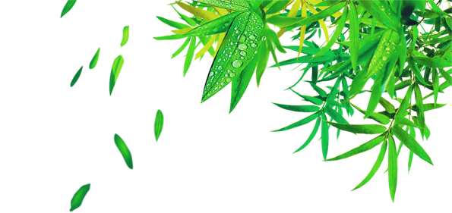

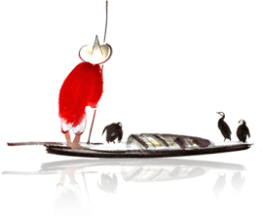
The Dragon Boat Festival
六一班 秦子皓

Slide 2
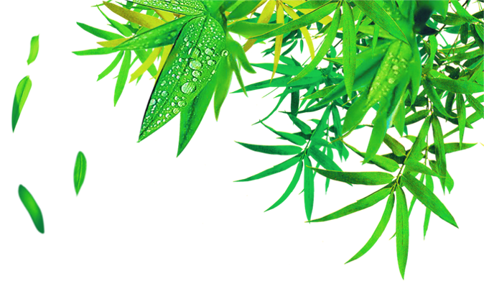
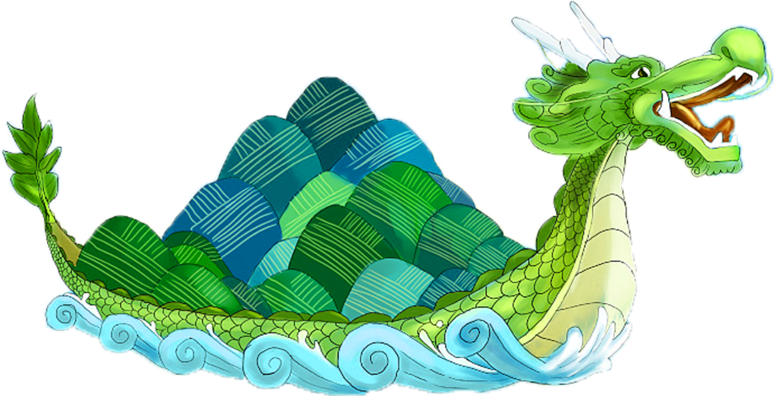
Origin of Dragon Boat Festival
端午的由来
1
Custom of Dragon Boat Festival
端午的习俗
2

Slide 3
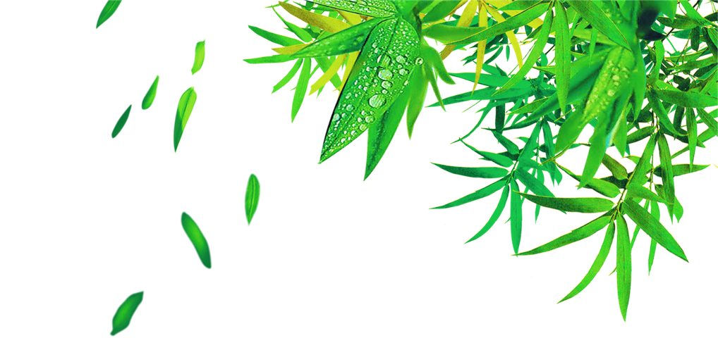
Origin of Dragon Boat Festival

Slide 4
THE INTRODUCTION
The Dragon Boat Festival,also called the Duanwu Festival,is celebrated on the fifth day of the fifth month according to the Chinese calendar. This festival is to commemorate the death of Qu Yuan,who is said to have committed suicide by drowning himself in a river.

Slide 5
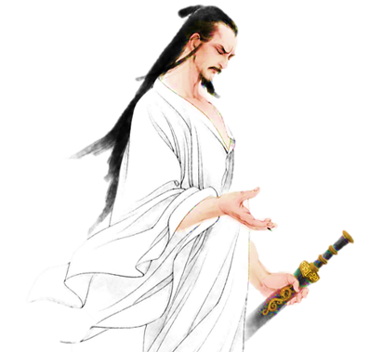
HISTORY
The Dragon Boat Festival, the 5th day of the 5th month in the Chinese lunar calendar, has had a history of more than 2,000 years. It is usually in June in the Solar calendar.

Slide 6
Custom of Dragon Boat Festival

Slide 7
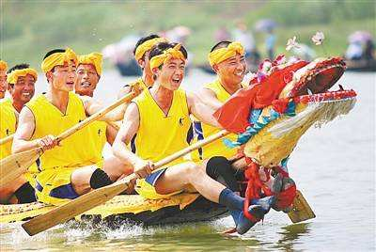

Hanging Pictures of Zhong Kui
Hanging Calamus and Moxa
The Culture of Zongzi

Slide 8
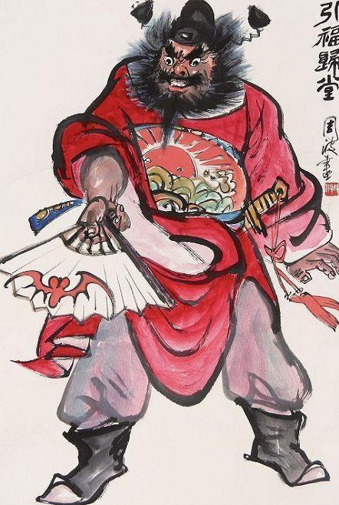
Hanging Pictures of Zhong Kui
Zhong Kui is right in the south. In Chinese folklore, God can drive away evil spirits. In the old days, Chinese folk often hung Zhong Kui's image to ward off evil spirits and eliminate calamity.

Slide 9
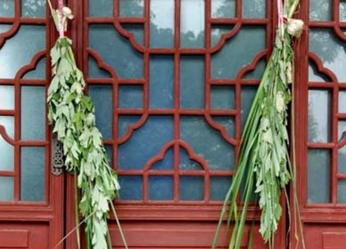
Hanging Calamus and Moxa
Acorus is a Chinese folk festival custom, in the Dragon Boat Festival with the leaf in the hall hanging in the hall, cut Aili tiger shaped or cut color for small tigers, pasted with AI leaves, women strive to wear, in the secluded evil drive miasma. Using calamus as a sword and inserting it on the door couch, there is the magic effect of exorcism.

Slide 10
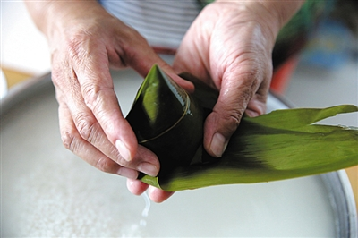
Zongzi is a traditional custom of the Dragon Boat Festival. First of all, prepare the zongzi leaves. The zongzi leaves of the old Beijing dumplings are usually reed leaves. They are called Zongye leaves on the dumplings. Next is to prepare the stuffing in the dumplings, put the stuffing in the leaves of zongzi, and the rice dumplings are finished.
The Culture of Zongzi

Slide 11

The Dragon Boat Festival

